Slide 1
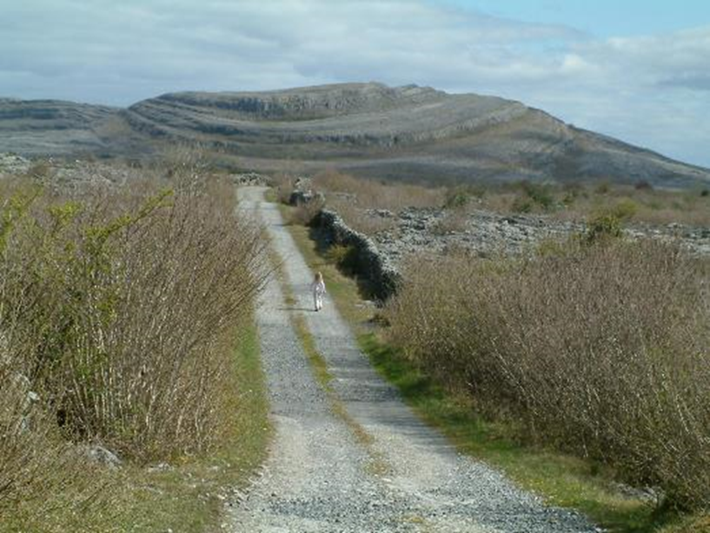
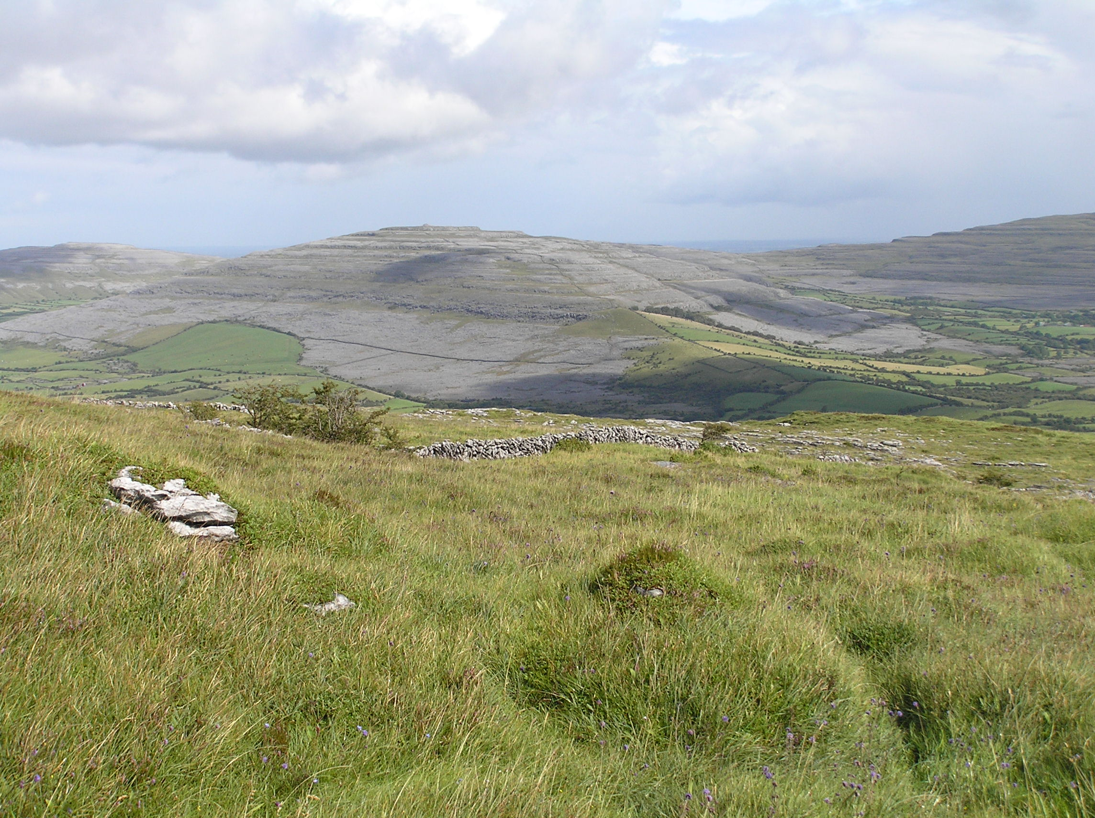
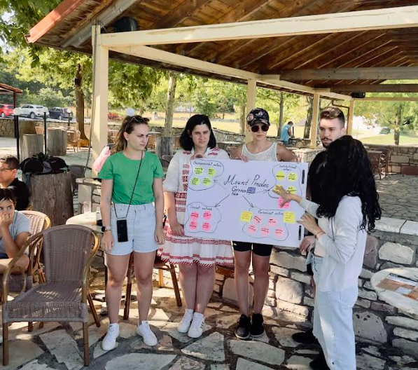
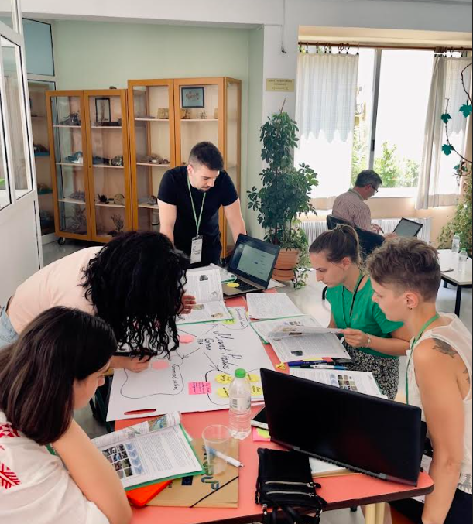
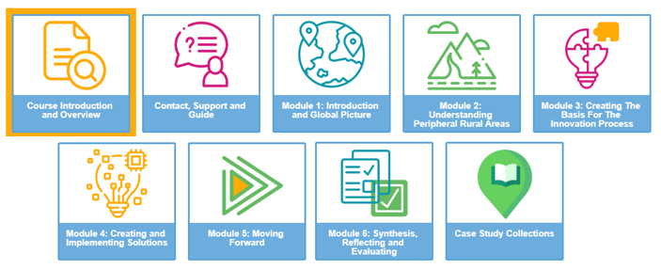
BUDI UZOR®/INOVA 2022.
12.-14.10.2022. Osijek
INNOVATIVE EDUCATION FOR SUSTAINABLE DEVELOPMENT IN PERIPHERAL RURAL AREAS
I. Herzon, D. Gaki, S. Felekis, J. Moran, T. Berchoux, G. Blachos, S. Bäckström, Y. Kazakova,
M. Kessari, O. Klepac, V. Mihai, M. Puig-de Morales Fusté, M. Jitea, S. Tolic, M. Roglic
Aims
DELIVERABLES – intelectual outputs (IO)
1) deepen an understanding of the specific skills and competencies needed by the labor market and society in such regions
2) support curriculum development to ensure learning for the skills and competencies
3) strengthen cooperation between Higher Education and potential regional and cross-regional employers
IO 1
Educational needs & gaps for sustainable development of the EU perioheral rural areas
IO6
Reflective report on the approach and methodology
IO2
E-learning course – syllabus and materials
4) support professional competences of HE educators in such regions
5) contribute to the international pool of open educational resources
IO5
Syllabus and materials for Intensive Study Activity (Summer School)
IO3
Bank of case studies
IO4
Digital Teaching Platform and Digital Learning Resources
EPALE
Ambition: to improve capacity for sustainable development in peripheral rural areas across Europe
Strong involvement of stakeholder representatives in the process of developing educational materials
MAJOR EDUCATIONAL ACTIVITIES & INOVATIONS
E-course - foundation for the summer school
50 students from 7 countries – spring 2022.
5 modules offered through a special interactive e-learning platform (CPD learn online)
In-field Summer School
35 participants in Pindos mountain area, Greece, July 2022.
Studnts acted as regional experts in participatory innovation process to engage in a multi-cultural and multidisciplinary hands-on learning
Digital Teaching Platform and Digital Learning Resources for HE teachers and Advisors
EPALE - Electronic Platform for Adult Learning in Europe
https://epale.ec.europa.eu/en
Partners:
Contacts:
Snježana Tolić: stolic@fazos.hr
Olgica Klepač: oklepac@fazos.hr
www.rurup.uth.gr
STRATEGIC PARTNERSHIP (KEY ACTION 2) - RUR’up Project: “Innovative education for sustainable development in peripheral rural areas” under the Agreement n° 2020-1-EL01-KA203-079121
The European Commission support for the production of this publication does not constitute an endorsement of the contents which reflects the views only of the authors, and the Commission cannot be held responsible for any use which may be made of the information contained therein.

